Slide 1
Lecture 6
Signals and Systems (ELL205)
By Dr. Abhishek Dixit
Dept. of Electrical Engineering
IIT Delhi

Slide 2
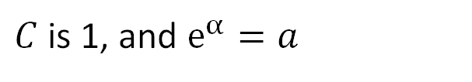

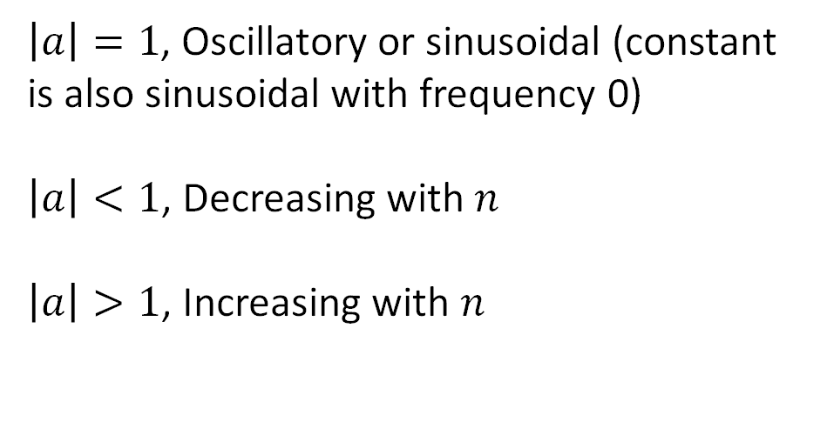

Exponential
$$Ce^{αn}$$
$C$ is 1, and $e^{α}=a$
$$a^{n}$$
$\left|a\right|=1$, Oscillatory or sinusoidal (constant is also sinusoidal with frequency 0)
$\left|a\right|<1$, Decreasing with $n$
$\left|a\right|>1$, Increasing with $n$

Slide 3
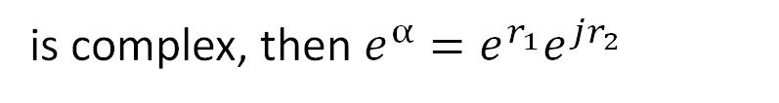

Exponential
$$Ce^{αn}$$
$C$ is 1, and $e^{α}=a$
$$α$$
is complex, then $e^{α}=e^{r_{1}}e^{jr_{2}}$

Slide 4
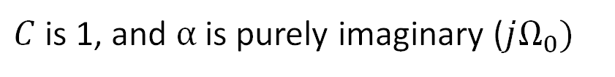
Exponential
$$Ce^{αn}$$
$C$ is 1, and $α$ is purely imaginary ($jΩ_{0})$
$$e^{j{(Ω}_{0}+2mπ)n}=e^{jΩ_{0}n}e^{j2mnπ}=e^{jΩ_{0}n}$$
Signal with frequency $Ω_{0}$ and signal with frequency $Ω_{0}+2mπ$ are the same.
Frequency wrapping.

Slide 5
System Properties

Slide 6
Outline of the Lecture
System Properties
  Memoryless
  Causal
  Invertible
  Stable
  Time invariant
  Linear
  Incrementally Linear

Slide 7
Outline of the Lecture
System Properties
  Memoryless
  Causal
  Invertible
  Stable
  Time invariant
  Linear
  Incrementally Linear

Slide 8
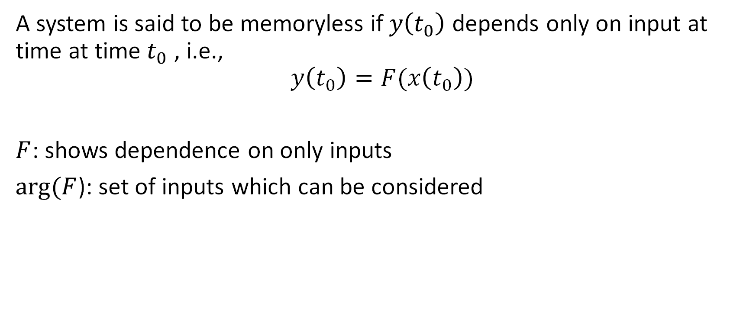
Memoryless
A system is said to be memoryless if $y\left(t_{0}\right)$ depends only on input at time at time $t_{0}$ , i.e.,
$$y\left(t_{0}\right)=F(x\left(t_{0}\right))$$
$F$: shows dependence on only inputs
$arg⁡(F$): set of inputs which can be considered

Slide 9
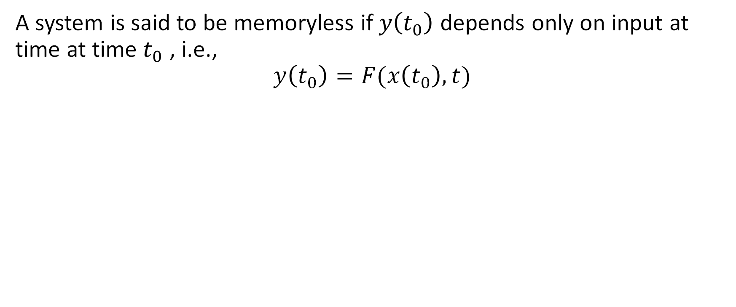
Memoryless
A system is said to be memoryless if $y\left(t_{0}\right)$ depends only on input at time at time $t_{0}$ , i.e.,
$$y\left(t_{0}\right)=F(x\left(t_{0}\right),t)$$

Slide 10
How many of them are memoryless systems?
A)
B)
C)
D)
NONE !!

Slide 11
Memoryless
Is differentiator memoryless?

Slide 12
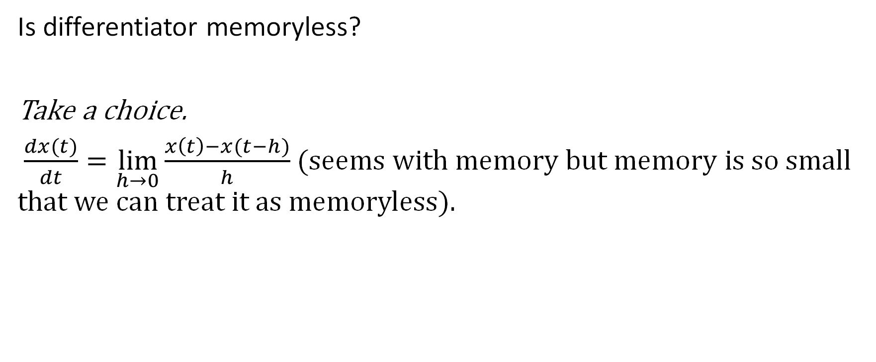
Memoryless
Is differentiator memoryless?
Take a choice.
$\frac{dx(t)}{dt}=\lim_{h→0}{\frac{x\left(t\right)−x(t−h)}{h}}$ (seems with memory but memory is so small that we can treat it as memoryless).

Slide 13
Outline of the Lecture
System Properties
  Memoryless
  Causal
  Invertible
  Stable
  Time invariant
  Linear
  Incrementally Linear

Slide 14
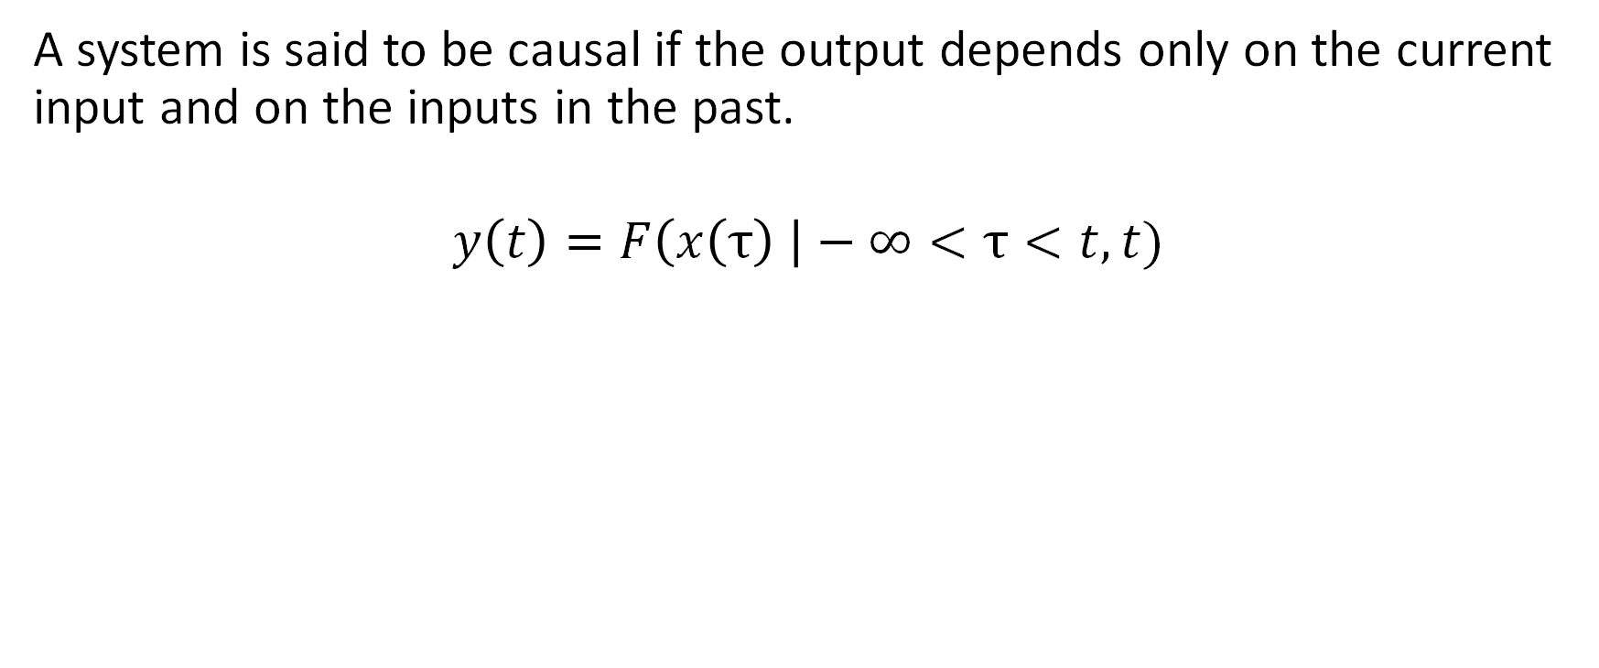
Causal
A system is said to be causal if the output depends only on the current input and on the inputs in the past.
$$y\left(t\right)=F\left(x\left(τ\right) \right|−∞<τ<t,t)$$

Slide 15
Causal
A system is said to be causal if the output depends only on the current input and on the inputs in the past.
Output does not depend on inputs in future (non-anticipatory system)

Slide 16
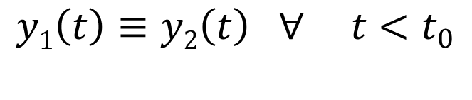

Causal
A system is said to be causal if the output depends only on the current input and on the inputs in the past.
Output does not depend on inputs in future (non-anticipatory system)
Formal:
$x1\left(t\right)≡x2\left(t\right) ∀ t<t_{0}$
$$y1\left(t\right)≡y2\left(t\right) ∀ t<t_{0}$$

Slide 17
How many of them are causal systems?
A)
B)
C)
D)

Slide 18
How many of them are causal systems?
A)
B)
C)
D)

Slide 19
Outline of the Lecture
System Properties
  Memoryless
  Causal
  Invertible
  Stable
  Time invariant
  Linear
  Incrementally Linear

Slide 20
Invertible
A system is said to be invertible if distinct inputs lead to distinct outputs.

Slide 21


Invertible
A system is said to be invertible if distinct inputs lead to distinct outputs.
S
S⁻¹
$$x(t)$$
$$x\left(t\right)$$
Invertible Inverse

Slide 22
How many of them are invertible systems?
A)
B)
C)
D)

Slide 23
How many of them are invertible systems?
A)
B)
C)
D)

Slide 24
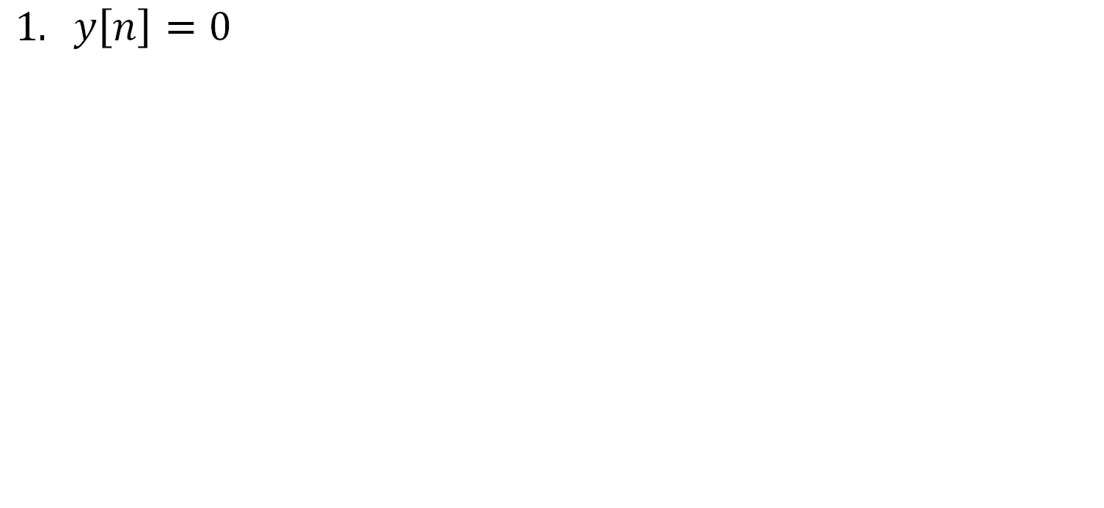
Invertibility: Discrete Time Systems
$$1. y\left[n\right]=0$$
0
S
5
0
10
0
System is not invertible.

Slide 25
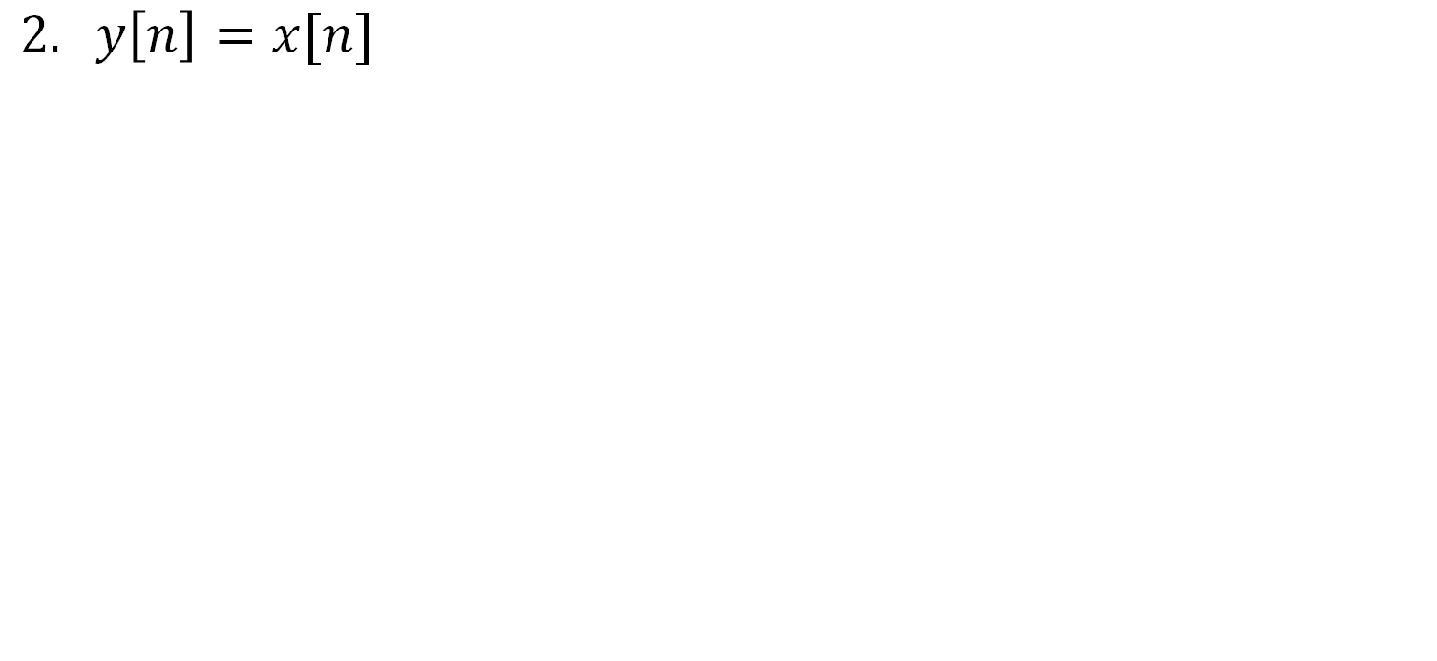
Invertibility: Discrete Time Systems
$$2. y\left[n\right]=x[n]$$
0
S
2
2
4
4
System is invertible.

Slide 26
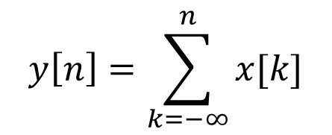
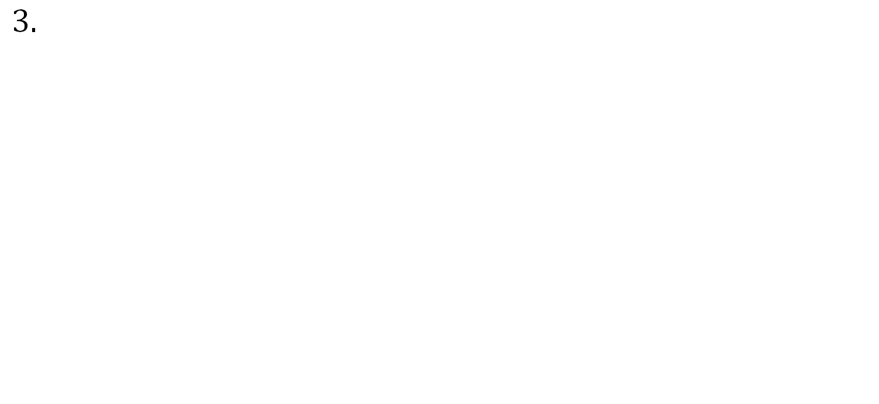
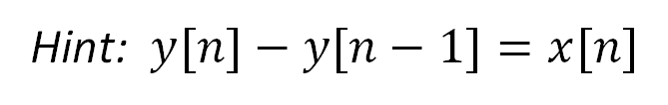
Invertibility: Discrete Time Systems
$$y\left[n\right]=\sum_{k=−∞}^{n}{x[k]}$$
$$3.$$
Hint: $y[n]−y[n−1]=x[n]$
0
S
2
2
4
6
System is invertible.

Slide 27

Invertibility: Discrete Time Systems
$$y\left[n\right]=x\left[n\right]−x[n−1]$$
$$3.$$
0
S
10
2
16
6
System is not invertible.

Slide 28
Outline of the Lecture
System Properties
  Memoryless
  Causal
  Invertible
  Stable
  Time invariant
  Linear
  Incrementally Linear

Slide 29
Stable
A system is said to be stable if bounded inputs lead to bounded outputs.

Slide 30
Stable
A system is said to be stable if bounded inputs lead to bounded outputs.
Stability is BIBO stability

Slide 31
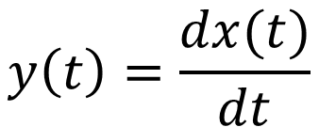
How many of them are stable systems?
A)
B)
C)
D)
$$y\left(t\right)=\frac{dx(t)}{dt}$$

Slide 32
How many of them are stable systems?
A)
B)
C)
D)
$$y\left(t\right)=\frac{dx(t)}{dt}$$

